Slide 1
Spotify Content-Based
Music Recommendation System
953
songs
Exploratory Data Analysis of the Spotify 2023 Dataset
8 audio features
What does the audio-feature space look like before we measure song similarity?
Priscilla Yinzime ,Megan Millet,Carson Vrba,Gbenga Solomon
Notes:
Opening: Our group is building a content-based music recommendation system. My part for this presentation is the exploratory data analysis.,The purpose of the EDA is not just to make plots. We want to understand the audio variables that will later define similarity between songs.,I will stop at the scatterplots today. The next phase is preprocessing and standardization before KNN.

Slide 2
Why EDA comes before the recommender
GOAL
We first need to understand the variables that will define “similarity” between songs.
1. Data quality
2. Feature behavior
3. Feature relationships
Are the audio features complete? Are values valid? Are there duplicate song records that could contaminate recommendations?
What do BPM, danceability, energy, valence, acousticness, instrumentalness, liveness and speechiness actually look like?
Are any variables almost duplicates of one another? Which musical characteristics tend to move together?
EDA → preprocessing decisions → similarity model
Notes:
The recommender will compare songs using numerical audio characteristics. So before computing distances, we need to know whether those variables are usable and what their distributions look like.,This makes the EDA directly connected to the recommender rather than a separate exercise.

Slide 3
Dataset snapshot
DATA
Spotify 2023 provides a compact catalog with complete numerical audio features.
953
24
8
songs
variables
audio features
BPM
Danceability
Valence
Energy
Acousticness
Instrumentalness
Liveness
Speechiness
track_name and artist(s)_name identify songs; the 8 audio variables define the initial content profile.
Notes:
The baseline recommender will use these eight features to represent each song numerically.,Track name and artist name are identifiers. They help us find and display songs, but they are not part of the numerical distance calculation.

Slide 4
Data quality check
QUALITY
The selected audio features are complete and within plausible ranges, but repeated song–artist records need inspection.
0
0
4
0
missing values
in audio features
fully duplicated
rows
repeated track–artist
combinations
range violations
in selected features
Why the repeated tracks matter
Important modeling implication
If a track appears twice, the system might later recommend the same song back to the user under another record. We therefore inspect the repeated track–artist combinations before modeling.
Because the eight audio features have no missing values, the baseline recommender does not require imputation for these variables. That keeps the first model clean and easy to interpret.
Notes:
This is a very useful result: the eight audio features have zero missingness, so we do not need an imputation strategy for the baseline model.,There are four repeated track-artist combinations. We should inspect them instead of deleting them blindly, because some may be legitimate versions or slightly different records.

Slide 5
Descriptive statistics
SUMMARY
The features differ substantially in center, spread and range.
Feature | Mean | Median | SD | Min | Max
BPM | 122.5 | 121.0 | 28.1 | 65 | 206
Danceability | 67.0 | 69.0 | 14.6 | 23 | 96
Valence | 51.4 | 51.0 | 23.5 | 4 | 97
Energy | 64.3 | 66.0 | 16.6 | 9 | 97
Acousticness | 27.1 | 18.0 | 26.0 | 0 | 97
Instrumentalness | 1.6 | 0.0 | 8.4 | 0 | 91
Liveness | 18.2 | 12.0 | 13.7 | 3 | 97
Speechiness | 10.1 | 6.0 | 9.9 | 2 | 64
Instrumentalness stands out
Mean = 1.6%, median = 0%. About 90.9% of songs have instrumentalness exactly 0.
Scale and spread differ
BPM ranges from 65 to 206, while the percentage variables have different spreads. Raw Euclidean distance would therefore not treat every feature comparably.
Notes:
The descriptive statistics already tell us that the features behave very differently.,Instrumentalness is especially unusual: the median is zero and about 90.9% of tracks have zero instrumentalness.,This is one reason we should not jump directly into KNN before examining distributions and scaling.

Slide 6
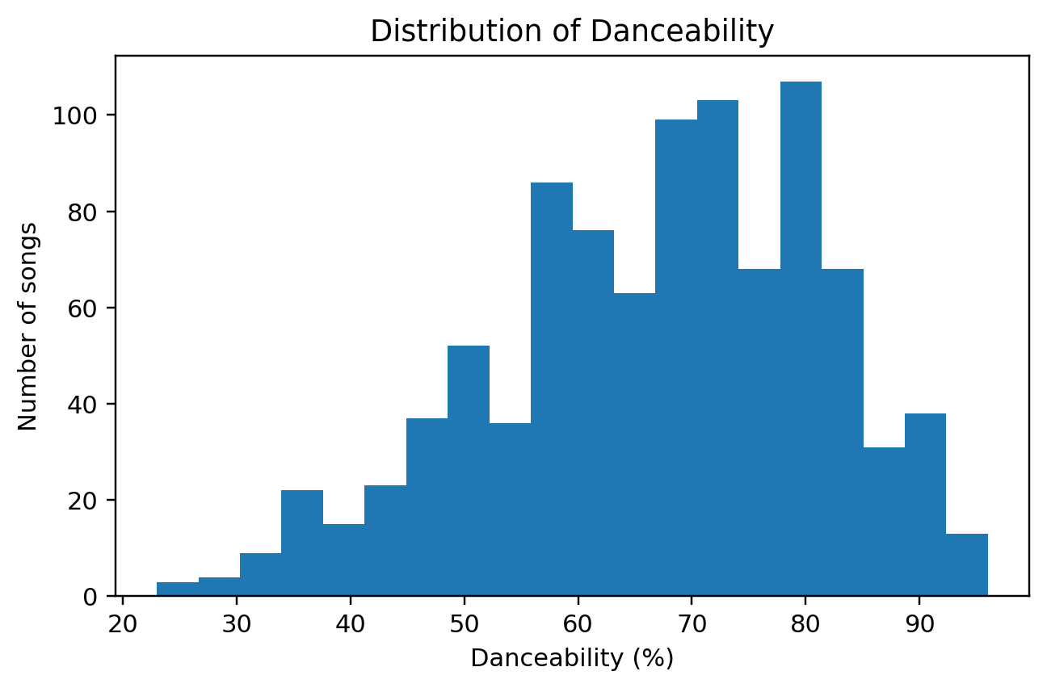
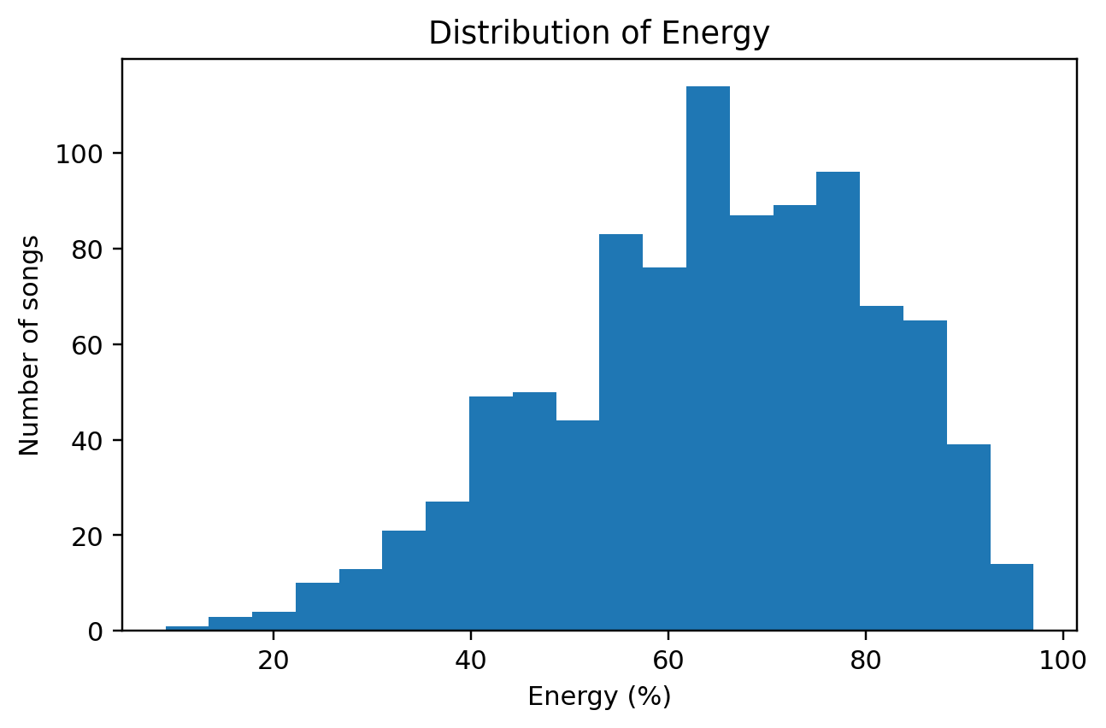
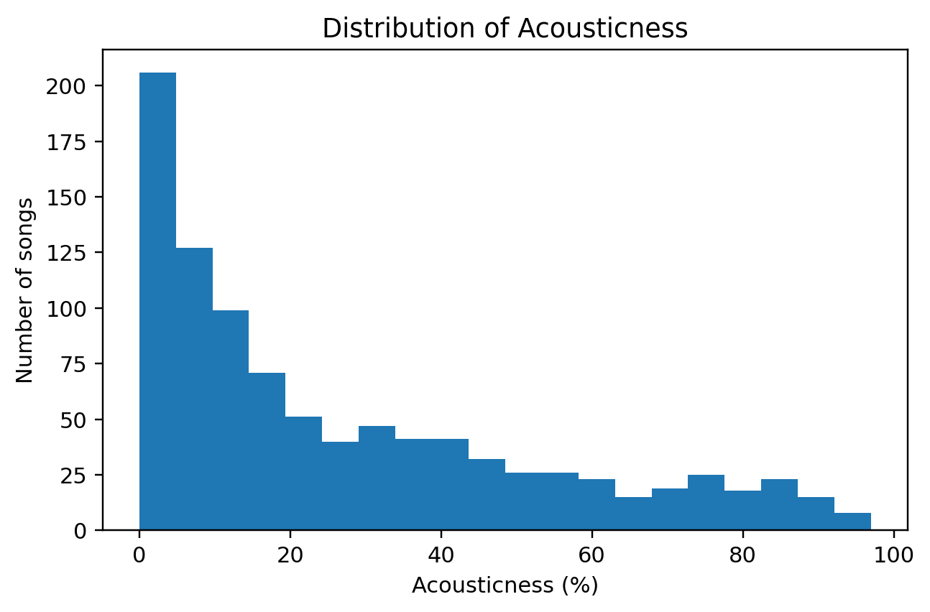
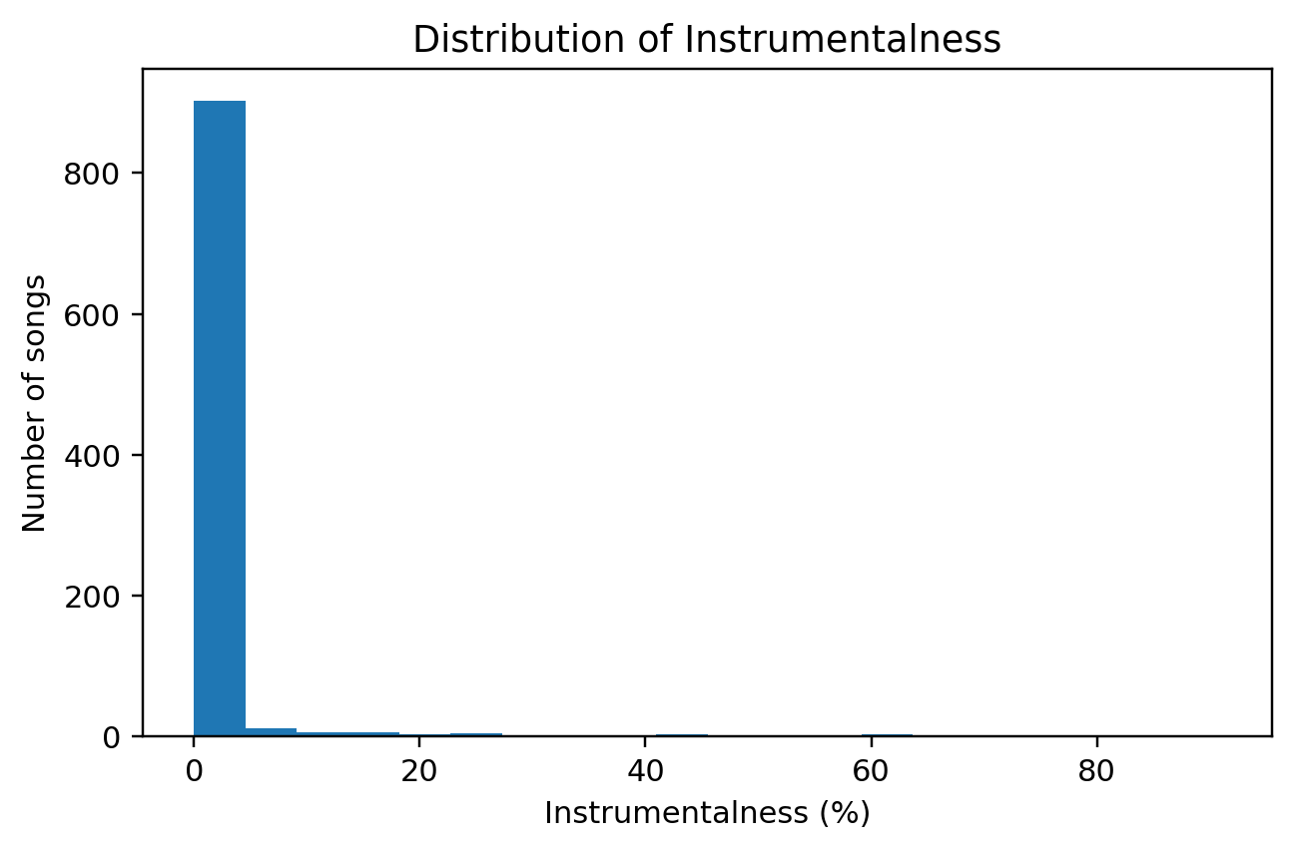
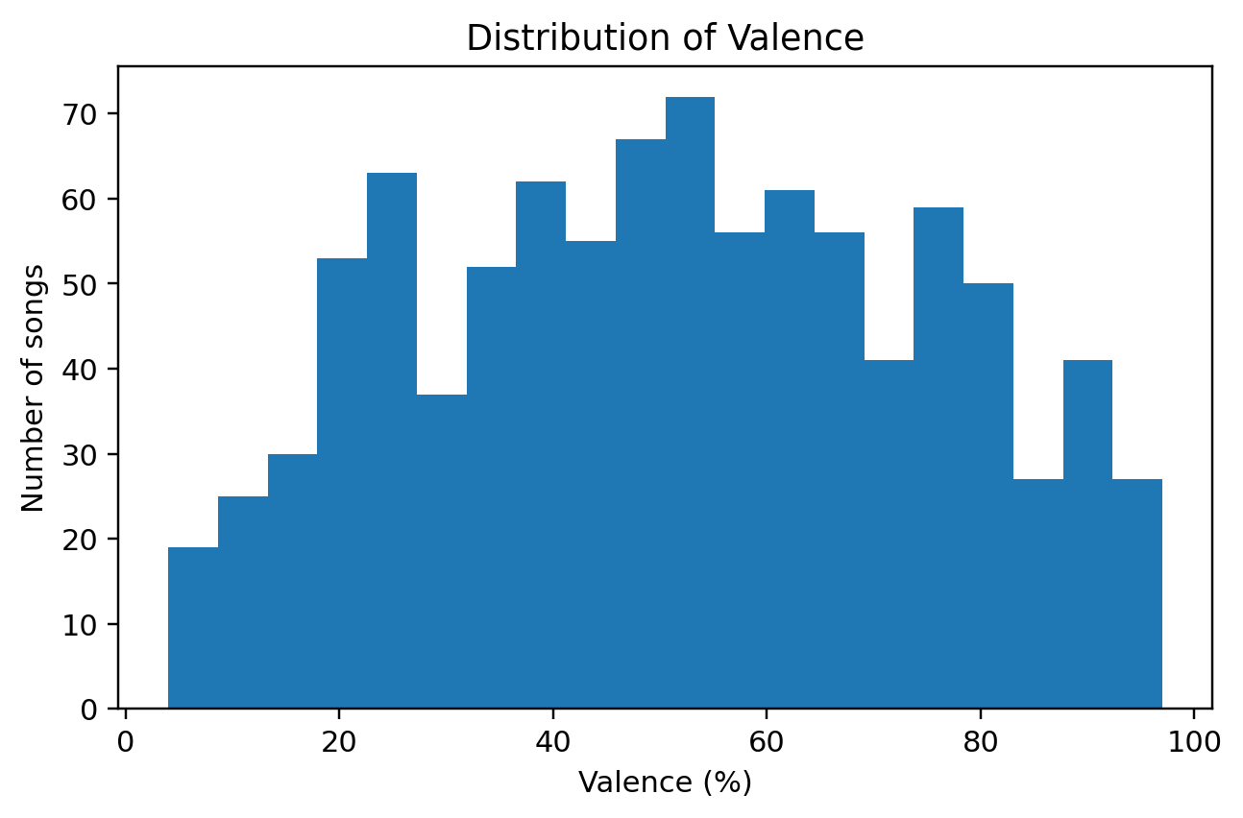
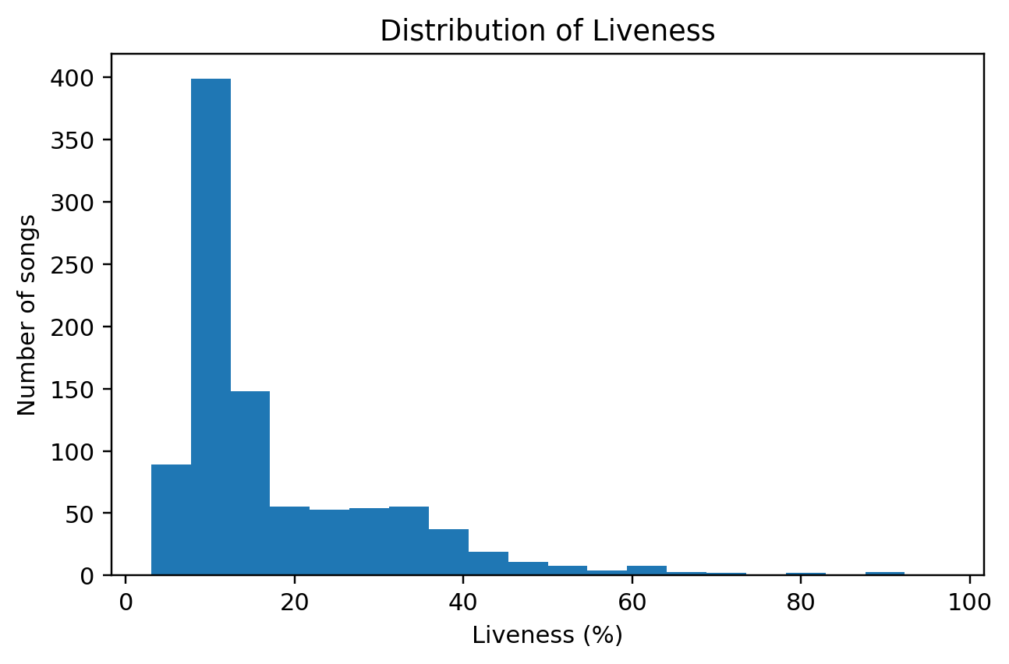
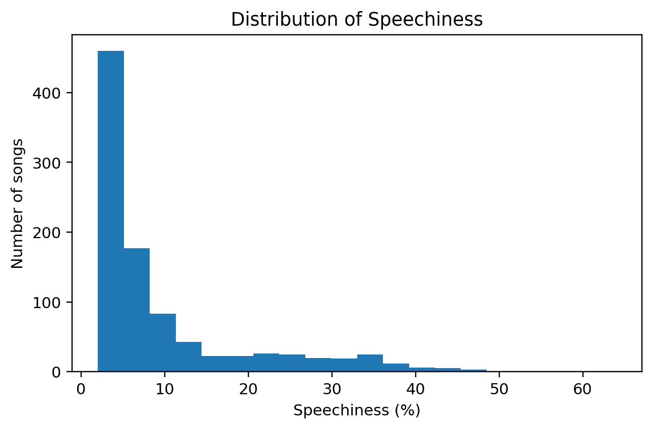
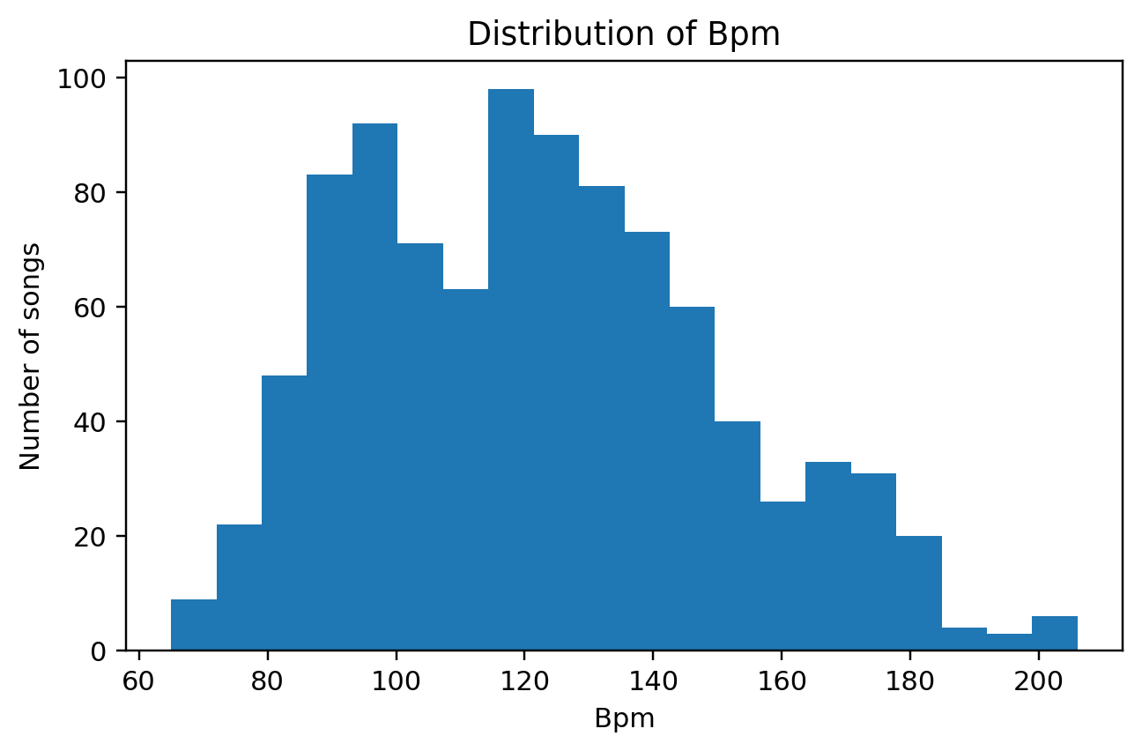
Feature distributions
DISTRIBUTIONS
The catalog is not uniform: some audio characteristics are broad, while others are strongly concentrated.
Notes:
This slide shows all eight feature distributions.,Valence is close to balanced, while acousticness is right-skewed and instrumentalness, liveness and speechiness have pronounced right tails.,The purpose is to understand what kinds of differences the distance metric will encounter later.

Slide 7
Skewness deserves attention
SHAPE
Several variables have long right tails; instrumentalness is the most extreme.
Feature | Skewness
instrumentalness | 7.12
liveness | 2.10
speechiness | 1.93
acousticness | 0.95
bpm | 0.41
valence | 0.01
danceability | -0.44
energy | -0.45
What this means for the recommender
A highly skewed feature can create unusually large standardized values for a small number of songs. We will therefore test later whether features such as instrumentalness improve recommendation quality or distort distance.
Notes:
Skewness quantifies the asymmetry we saw in the histograms.,Instrumentalness has skewness 7.12, much larger than the other features.,I am not removing it at the EDA stage. Instead, this becomes a future feature-ablation question for the recommender.

Slide 8
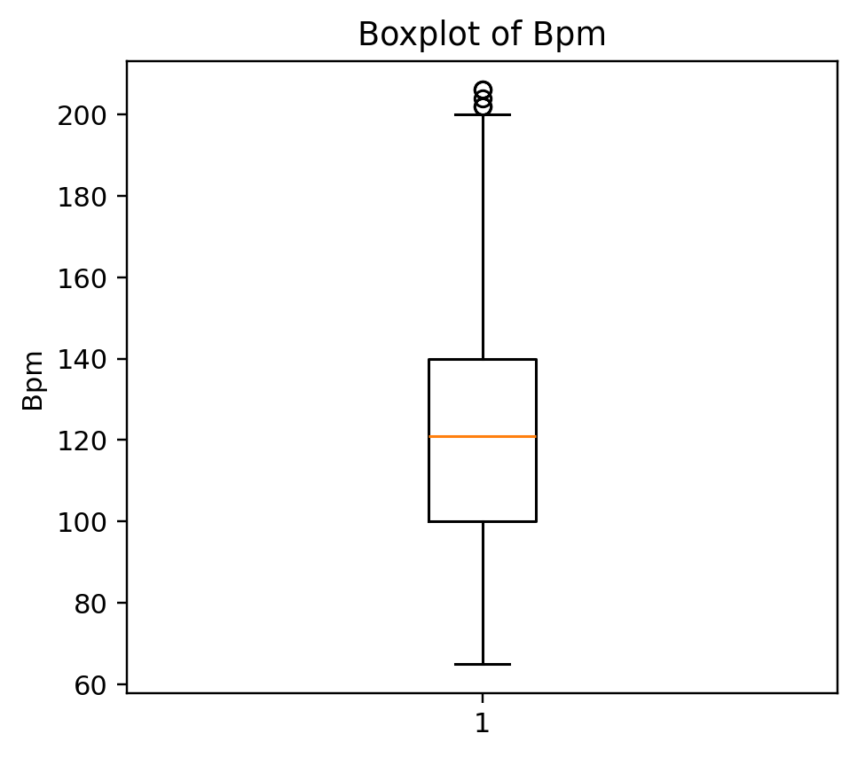
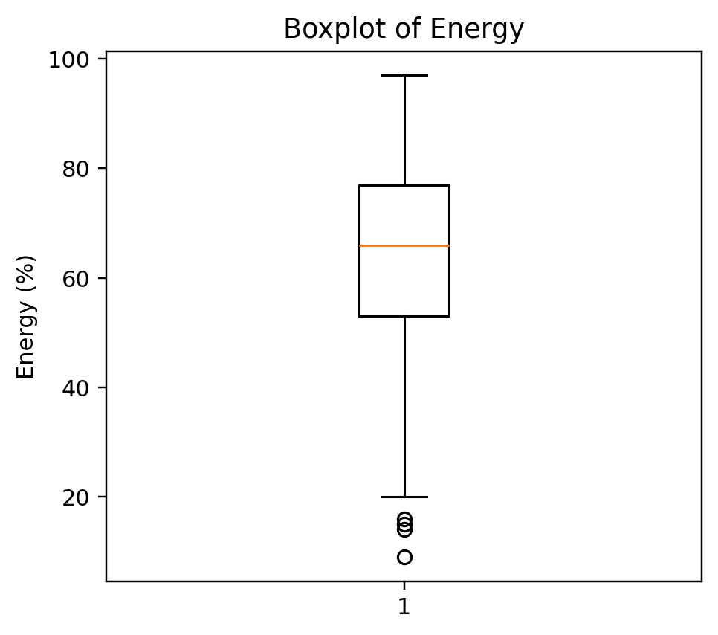
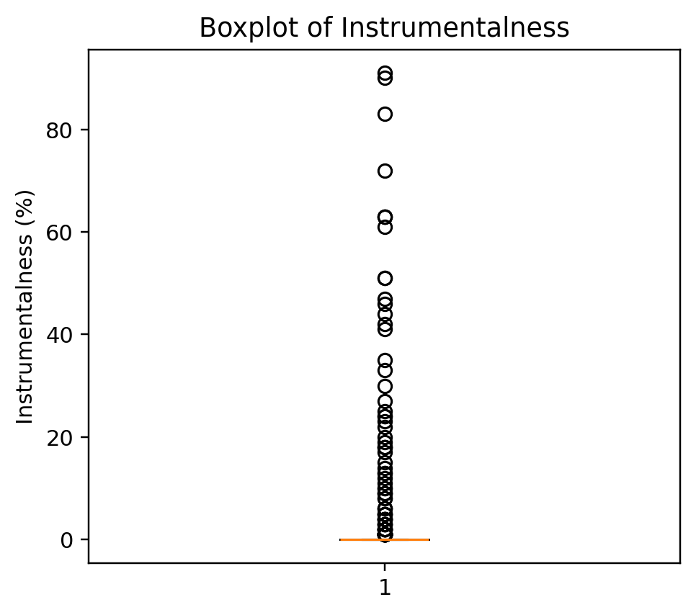
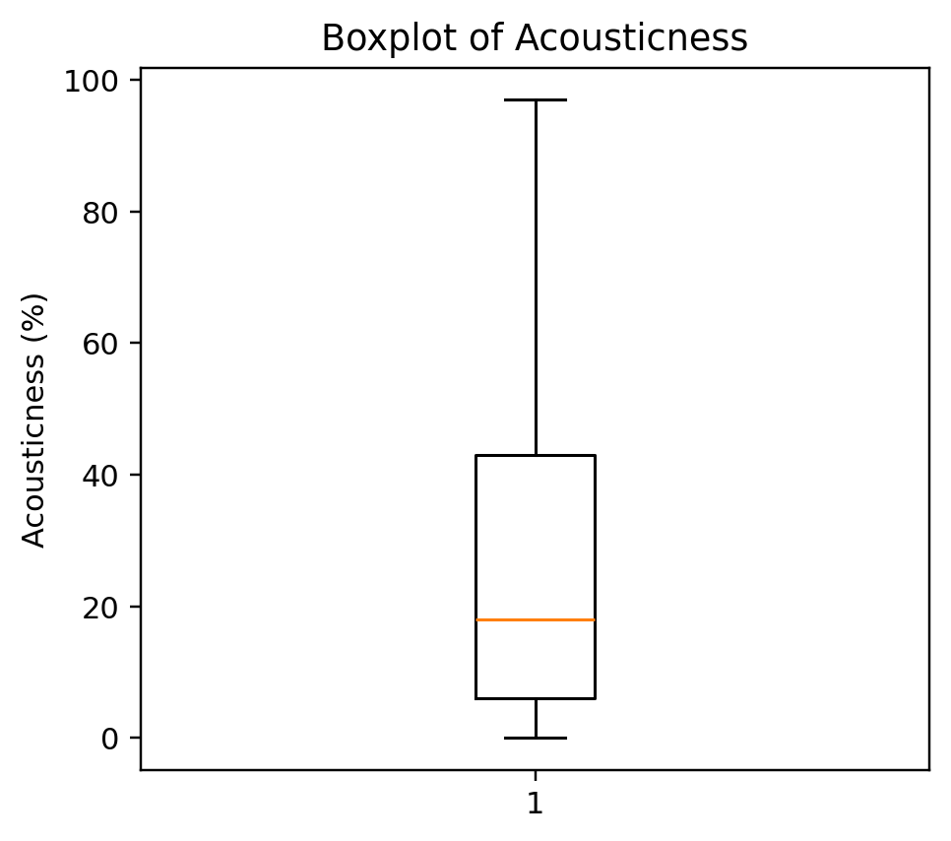
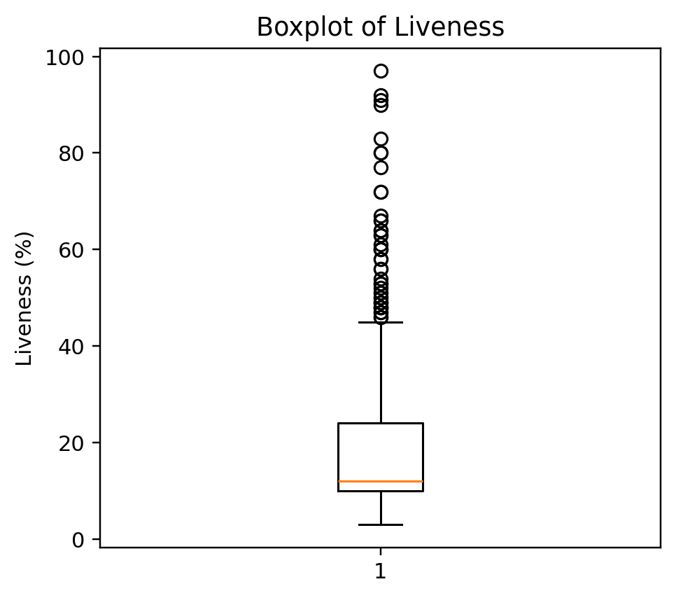
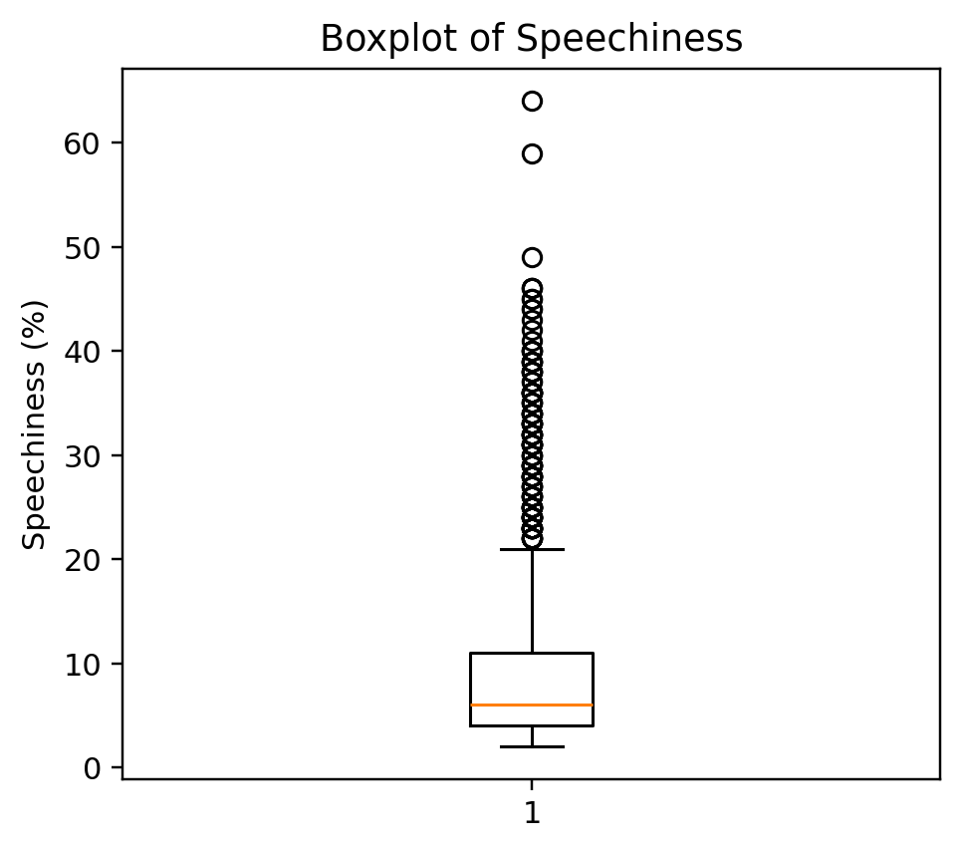
Boxplots: unusual does not mean wrong
OUTLIERS
Extreme musical characteristics may represent genuine genres or performance styles.
EDA decision: investigate extreme observations before deciding whether any should be removed.
Notes:
Boxplots flag observations that are unusual relative to the bulk of the sample.,But in music, high speechiness might represent rap or spoken-word tracks, and high instrumentalness may represent instrumental music. Those are real musical distinctions, not automatically errors.,So the correct EDA response is investigate, not delete.

Slide 9
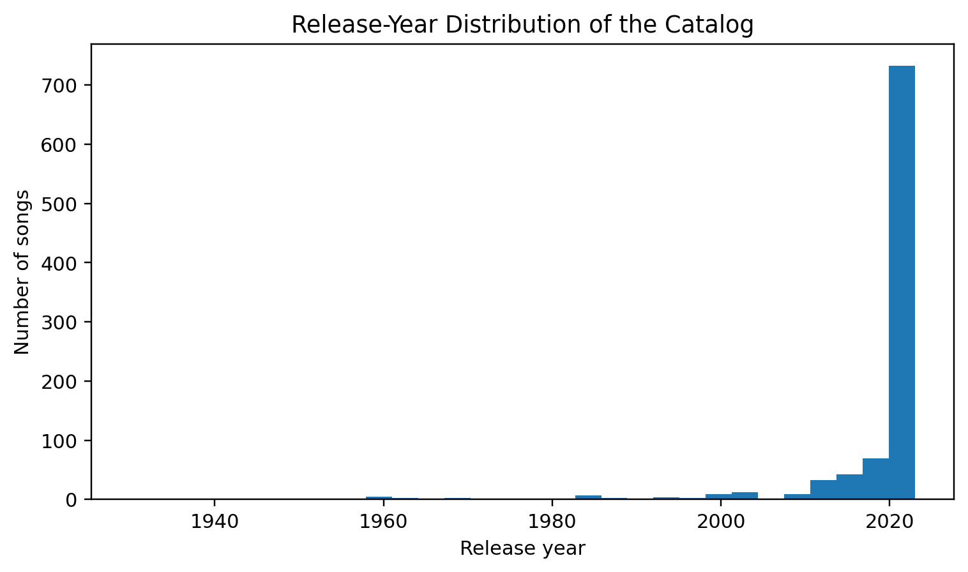
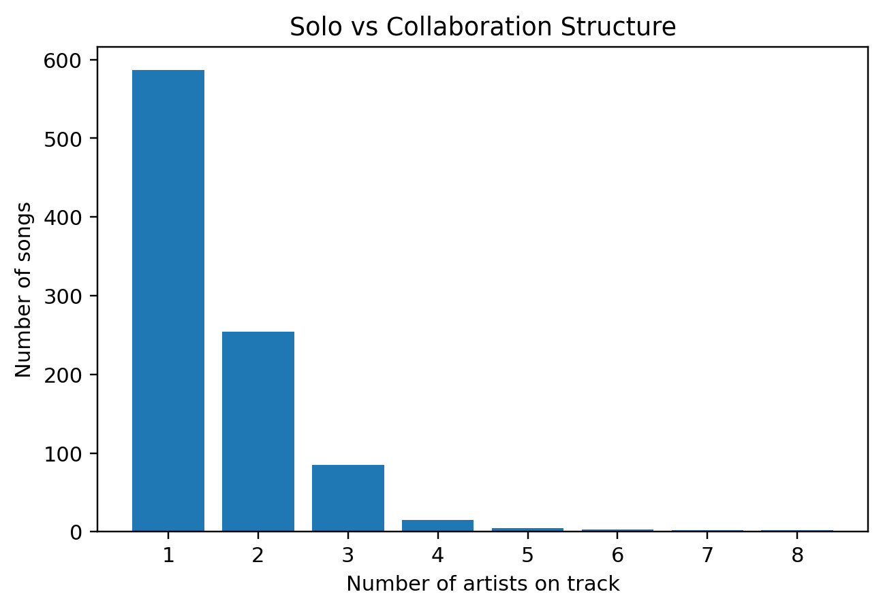
Catalog context
CONTEXT
What kind of music pool are we actually recommending from?
Catalog age
Artist structure
76.9% of songs were released in 2020 or later; the median release year is 2022.
587 of 953 tracks are single-artist songs; collaborations still make up a substantial part of the catalog.
Notes:
This is a useful limitation slide. The catalog is heavily concentrated in recent music.,That means the recommender may naturally favor newer popular songs because those are what the source dataset contains.,This is not a modeling error; it is a limitation of the recommendation pool.

Slide 10
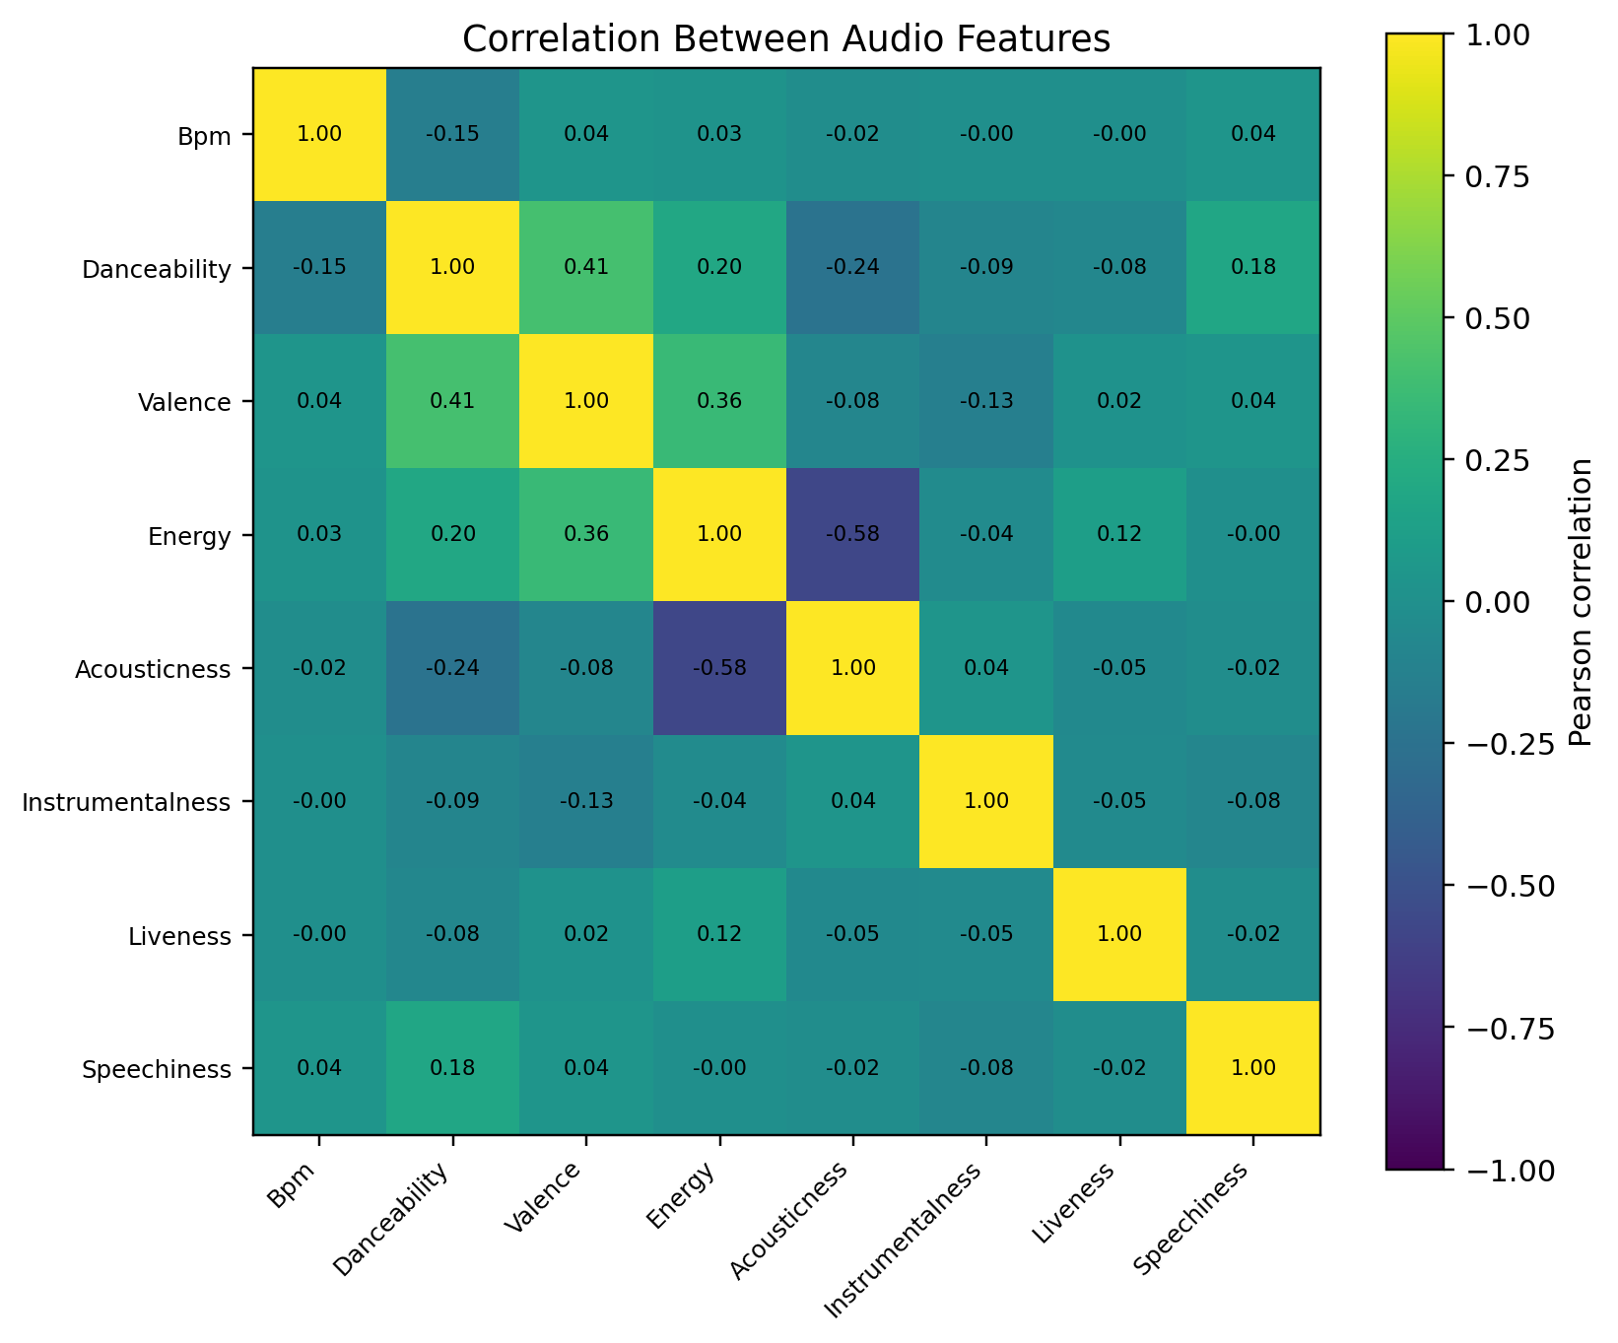
Correlation matrix
RELATIONSHIPS
We check whether some audio variables carry largely redundant information.
Strongest relationship
Energy vs acousticness: r = -0.58. More acoustic tracks tend to have lower energy.
Positive relationship
Danceability vs valence: r = 0.41. More danceable songs tend to have somewhat higher valence.
Redundancy check
No pair is close to ±1. At this stage, there is no obvious feature that should be removed simply because it duplicates another.
Notes:
Correlation measures linear association between pairs of audio features; it does not imply causation.,The strongest relationship is energy versus acousticness at r=-0.58.,Danceability versus valence is moderately positive at r=0.41.,Because no pair is extremely correlated, I would keep all eight features for the baseline and compare feature subsets later.

Slide 11
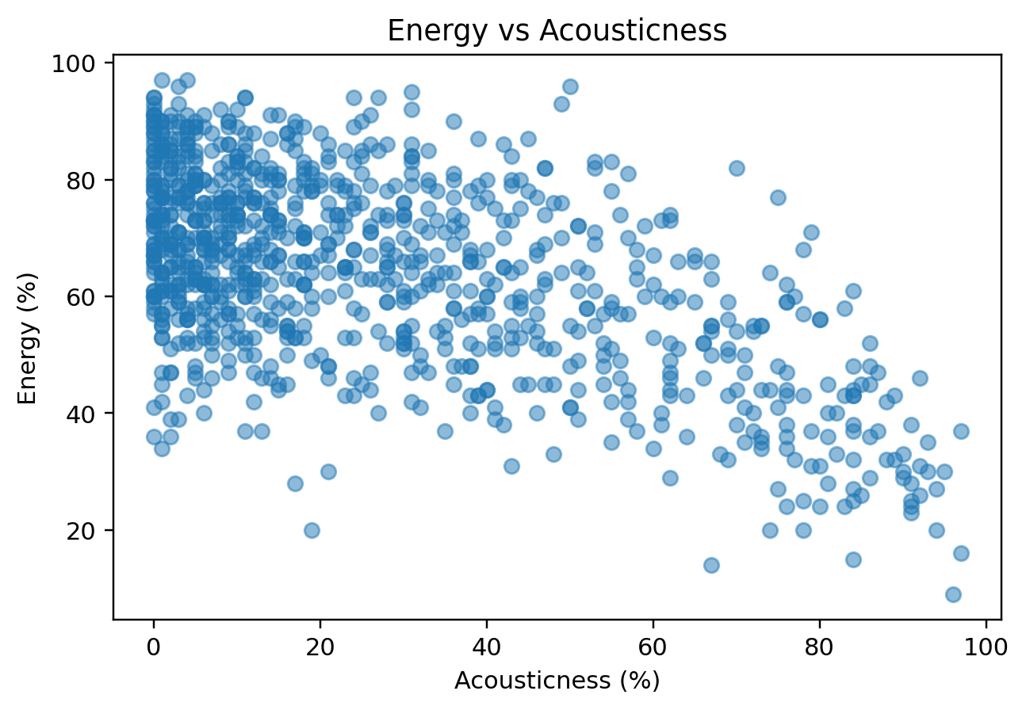
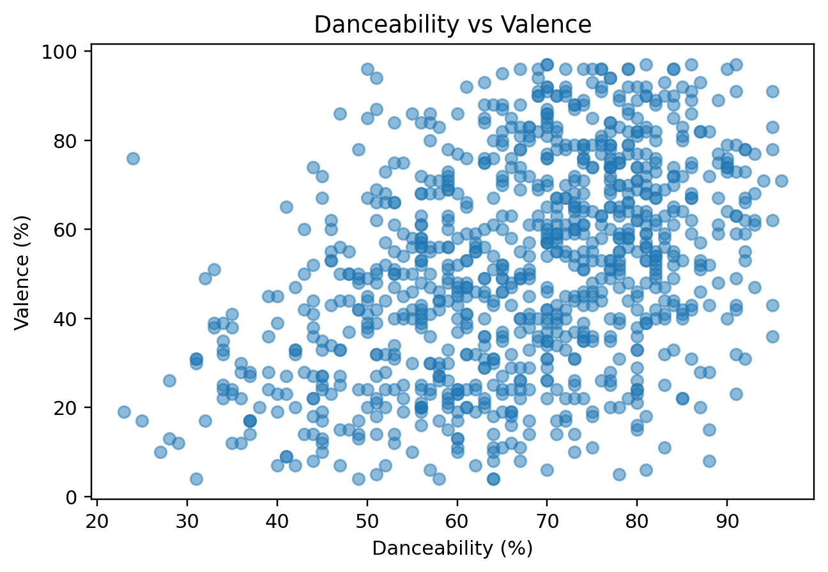
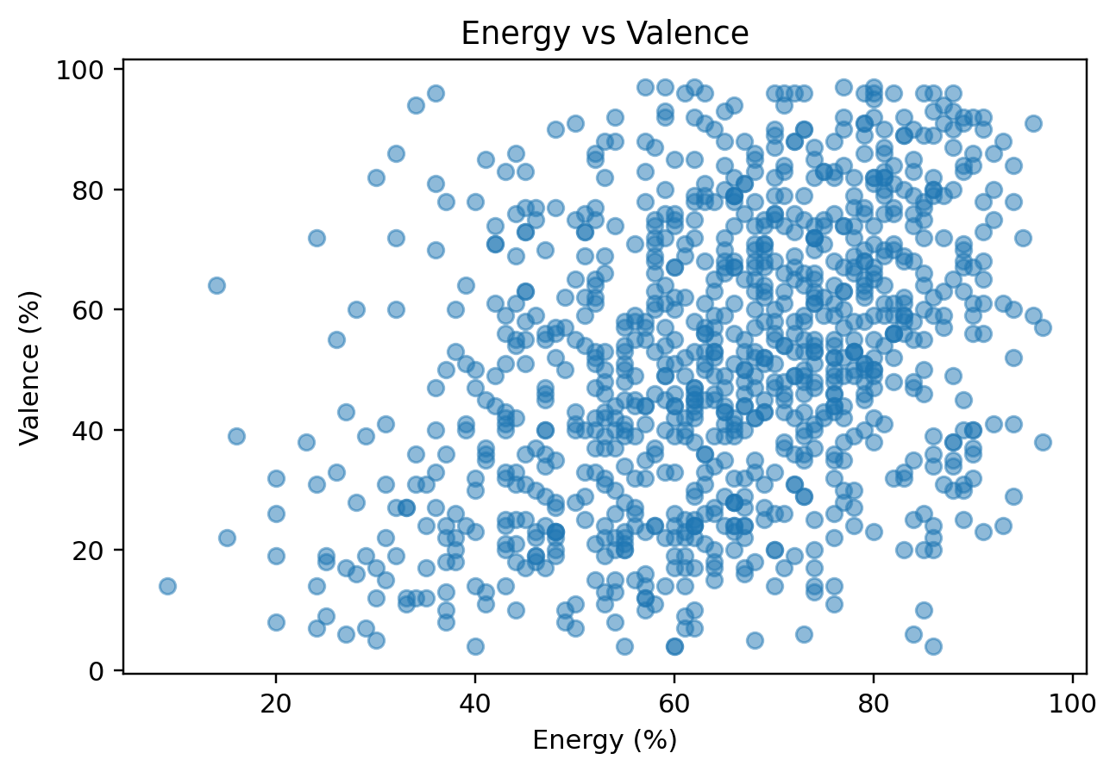
Scatterplots make the correlations tangible
SCATTERPLOTS
The same correlation coefficient can hide very different point patterns, so we inspect the actual observations.
Energy vs acousticness
Danceability vs valence
Energy vs valence
Clear downward tendency, but substantial scatter remains. Musical similarity cannot be reduced to one relationship.
A moderate positive trend: more danceable songs often have higher valence, but the relationship is far from deterministic.
A weaker positive relationship, suggesting these features still capture different aspects of a song.
Notes:
This is where I would stop the EDA presentation tomorrow.,The scatterplots validate the heatmap patterns but also show considerable variation, which is important because the recommender uses all features jointly.,The next stage is not more EDA; it is preprocessing and standardization before KNN.

Slide 12
What the EDA tells us — and what comes next
TAKEAWAYS
The exploratory analysis now gives us concrete modeling decisions.
Complete feature set
Standardization is necessary
All 8 audio features have complete observations.
The features have different scales and spreads, so raw Euclidean distances would not be comparable.
Keep all 8 for baseline
Catalog bias matters
No pair is so highly correlated that one obviously duplicates another.
The recommendation pool is dominated by recent songs, which limits what the system can suggest.
Investigate skewed features
Next phase
Instrumentalness is highly concentrated at zero and should be tested in later feature-ablation experiments.
Standardize the features → build baseline KNN → compare similarity methods and evaluate recommendations.
Notes:
Closing message: the EDA is not the final product. It gives us the basis for the next modeling phase.,The biggest immediate modeling decision is standardization before KNN because the features have different scales and spreads.,I would end here tomorrow and hand off to the next phase of the semester.

